Slide 1
Campus Occupational Safety and Health knowledge and education training promotion program of the Ministry of Education
Management of Laboratory Safety and Health
A1 Campus Safety and Health Foundation

Slide 2
Notices for use of the teaching material
Copyright of the slides of the teaching material (including text and image files) belongs to the ministry.
Core teachers: Any slide in the teaching material should be employed in full in teaching, without arbitrary revision and editing.
Credit is required for use of the material as reference in teaching.

Slide 3
Contents
I. Introduction
II. Common laboratory hazards
III. The importance of emergency response
IV. Laboratory safety and health management
Notes:
20160215
※通過培訓營認證教師使用此教材授課之教學說明：
初階(國民中小學)~p3-13, p21, p35-57, p93, p95
中階(高中/工/職)~p3-14, p17, p19-95
進階(大專校院)~p3-16, p18, p20-95

Slide 4
I. Introduction
Notes:
1.本單元為原本”實驗室安全衛生管理教材”之實驗室危害案例部分，其中一般高工職應不具有之危害類型，該投影片會加註“補充”兩字，例如游離輻射，另加入部分高工職相關案例。
2.請講師授課時依聽講者類型與所需，選擇合適之案例投影片進行講授。

Slide 5
Three major causes of disasters accidents
Note: in red frame.
Essence, character, fitness, physical strength and sensory ability
Machinery,
equipment or environments
Knowledge, awareness
and values
(Unsafe state)
Individual difference
Indirect cause
Operator
Combination
Disasters accidents
(Unsafe actions and behaviors)
Management and supervision
Basic cause
Direct cause
(Energy cannot be absorbed safely and exposure to hazardous substances)
(Improper management)
Notes:
20160215 教學目標
了解災害事故的三要因及其相關之因素

Slide 6
Accidents or incidents occur frequently in the laboratory
How to prevent it?

Slide 7
Environmental characteristics of the laboratory
Stored and placed kinds of hazardous, harmful or toxic chemical substances
Operating machinery requires proper protection and safe operating procedures
High turnover rate of staff or personnel
Operate various experiments in laboratory
Engaged in new research and development with unknown high risk
Numerous machinery and equipment
Notes:
20160215 教學目標
了解學校實驗室的基本特性
補充說明:
國內實驗場所曾經發生的災害案例顯示，大多數重大災害仍以實驗室化學性災害為主，因為：
1.實驗室內使用之化學品中屬於危險物、有害物或毒性化學物質，受到法規管制者超過 500 種；
2.雖然使用量少，但種類非常多；
3.在儲存、使用、管理及其所產生之廢液處理上，很容易因疏忽造成災害或不相容物質因意外起反應導致災害；
4.另外，學術機構實驗室因使用化學品之人員更替頻繁，新進人員為數眾多，在防範人為因素之災害上責任重大；
5.學術性研究又多為新的研發，未知風險很高。
6.再加上技術、設備、材料種類繁多，不停從事新研究又會持續添購儀器設備，使得空間擁擠，人與設備間缺乏安全距離，若隔離設施缺乏或不足，很容易發生事故。
例:某校使用雷射的實驗室，設置反射鏡改變雷射的指向，有反射鏡調整稍有偏差，使得雷射照射致某實驗人員的眼睛，送醫治療後發現視網膜有點狀燒焦的狀況，造成該人員視野中有黑點存在
7.實驗室各自獨立，實驗人員對其他實驗室的實驗內容與存在的危害類型、風險高低，通常不甚明瞭，一旦某實驗室發生災害，鄰近實驗室人員事前通常無所警覺，災害發生後也不知如何對應，容易連帶受傷害
例如大專院校實驗場所相關事故最重要之因素前五項為：危險物/有害物(20.1%)、電氣設備(12.3%)、化學設備(11.7%) 、材料(6.5%) 及其它(24.0%) 。

Slide 8
The importance of safety and hygiene in laboratory
The top five factors of accidents related to experimental sites in colleges and universities:
Hazardous substances (20.1%)
Electrical equipment (12.3%)
Chemical equipment (11.7%)
Material (6.5%)
Others (24.0%)
Notes:
20160215 教學目標
了解大專校院實驗場所意外事故比例

Slide 9
The importance of safety and hygiene in laboratory (cont.)
The top factors of accidents related to experimental sites in senior high school:
General power machinery(18.7%)
Manpower tools / hand tools (14.2%)
Other machinery (11.2%)
Appliance (8.2%)
Material (7.5%)
Others (9.0%)
Notes:
20160215 教學目標
了解高中高職實驗場所意外事故比例

Slide 10
II. Common laboratory hazards
Notes:
1.本單元為原本”實驗室安全衛生管理教材”之實驗室危害案例部分，其中一般高工職應不具有之危害類型，該投影片會加註“補充”兩字，例如游離輻射，另加入部分高工職相關案例。
2.請講師授課時依聽講者類型與所需，選擇合適之案例投影片進行講授。

Slide 11
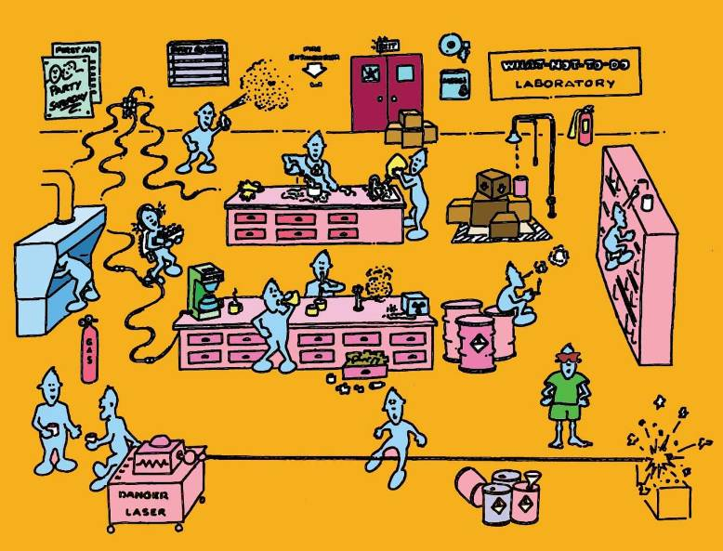
Potential laboratory hazards
Physical hazards: noise, vibration, radiation, electricity, mechanical hazards
Chemical hazards: fire, explosion
Biological hazards: infection, poisoning, allergy
Human-factor hazards: accumulated musculoskeletal disorder
Psychological hazard: pressure related to work sheet, burnout, etc.
Notes:
20160215 教學目標
了解學校實驗室的各種潛在危害

Slide 12
Physical hazards
Definition: Hazards to human body damage caused by physical energy, such as noise, radiation, abnormal temperature, vibration, lighting, and abnormal air pressure.
Notes:
12
20160215 教學目標
了解物理性危害定義
◎重點：物理性危害乃因為能量所引起！

Slide 13
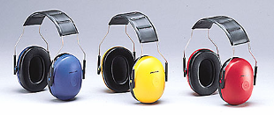
Noise hazards
  Definition: Sounds make people feel unpleasant or high decibel may cause auditory hazards and other adverse physical or psychological reactions
  Source: mechanical operation...
  Health hazard:
  hearing loss: temporary or permanent in nature
  Physiological and psychological effect: increased blood pressure and increased heart rate, etc.
Notes:
13
20160215 教學目標
了解噪音危害
重點提示:
噪音為一種使人產生不悅或音量過大可能導致聽覺危害與其他不良生心理反應之聲音。

Slide 14
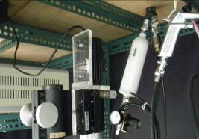
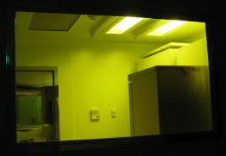
Non-ionizing radiation hazard
  Definition: The energy of electromagnetic radiation is less than 10 electron volts (eV), not enough energy to ionize atoms or molecules
  Source: ultraviolet ray, infrared, microwave, laser, etc.
  Health hazards: Thermal hazards (skin, eyes, etc.)
Laser equipment
UV germicidal lamp
Notes:
20160215 教學目標
了解非游離輻射危害（及非游離輻射定義）
補充說明:
1.雷射量測系統圖片來源： wwwme.nchu.edu.tw/~fluidlab/lab4.htm

Slide 15
Source of Non-ionizing radiation in experimental sites
Ultraviolet: UV germicidal lamp in biosafety cabinets and ceilings of certain biological laboratories, etc.
Infrared: Infrared drying equipment and oven, etc.
Microwave: Microwave digestion, open microwave heating equipment, etc.
Laser: Laser optical equipment, etc.
Notes:
20160215 教學目標
了解非游離輻射來源
補充說明:
例:某校生物課學生上課時，天花板的紫外線殺菌燈誤啟動，學生受殺菌級紫外線照射數小時，造成眼睛與皮膚傷害
紫外光殺菌燈的殺菌力視其產生的紫外光波長(例185 nm, 220 nm, 260 nm等, 若到365 nm等級應多屬應用紫外光探測材料結構傷害的檢測器材，而非殺菌)與強度而定，上述案例中的紫外光燈應屬波長較長，功率不是很強的紫外光燈，若是185 nm的紫外光殺菌燈，有些高強度等級的只要一照射到就會發生傷害。
避免過度暴露於非游離輻射的策略
1.工程改善策略
(1)電磁遮蔽
-採用低電阻的導電材料
-導體材料對電磁場具有反射與導引作用
-金屬材料的電磁屏蔽效果為電磁場的反射損耗、電磁場的吸收損耗與電磁場在遮蔽材料中的損耗三者之總和
銅、鎳具有優異的導電性，其電磁場干擾遮蔽效果極佳
2.非工程改善策略
(1)距離
-高壓輸電線
345kV高壓輸電線下方所測得的極低頻磁場強度可以達到50－250毫高斯
輸電線兩側一百公尺以外的地區所量測到的極低頻磁場強度只有1－3毫高斯，與一般環境中的背景強度2毫高斯類似
-吹風機
距吹風機10公分處測得高達100毫高斯之極低頻磁場
距吹風機50公分處降至1毫高斯
(2)時間:若無法使用距離防護原則，建議避免長時間使用電器設備
-吹風機
-行動電話

Slide 16
Abnormal temperature
Sources:
  Contact with utensils being heated
  Use of liquid nitrogen (boiling point at -196℃, brief contact with skin or eyes could cause frostbite or blindness)
  Use of freezer, etc.
Health hazard: Scald and frostbite
Preventive methods: In line with status of hazard, wear proper-grade heat-resistant gloves or cold-resistant gloves and protective goggles, as well as other protective gears.
Notes:
20160215 教學目標
了解異常溫度危害及預防

Slide 17
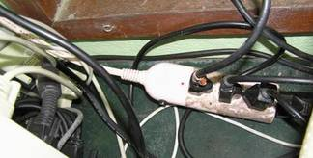
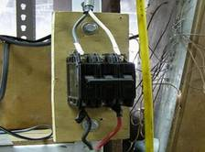
Electricity hazard
Definition: Injuries caused by contact of human body or equipment with electric current or electric current-induced high temperature.
Unsafe electric facility
Notes:
20160215 教學目標
了解電氣危害及預防
電氣危害防範措施：
1.隔離與接地
2.電氣設備安全保護裝置
3.電氣火災防止
4.電氣安全教育
5.電氣設備自動檢查與檢點
重點：以上圖說明電線裸露乃錯誤的配置，以下圖說明實驗室人員不應擅自使用延長線，應請專業電工配置電源插座。
補充說明:
延長線長時間放置於地面，易有絆倒、絕緣體破損感電的危險
同一插座接用過多插座，耗電量過大造成火災，一般的插座負荷上限為15安培
左圖延長線路配置混亂，容易勾到或絆倒、且顯然電流過大，延長插座本體已開始融化
右圖無熔絲開關上下接點金屬接頭裸露，容易誤觸觸電

Slide 18
Electrical hazards (cont.)
Electrical hazards in experimental sites:
  Inductive disaster
  The hazard caused by a part of the human body touching a power source to form an electrical circuit
  Burn caused by electric arc
  Short, grounding and flashover of circuit or electrical equipment all might cause the electric arc to burn a human body
Notes:
20160215 教學目標
補充說明:
-感電災害
胸部肌肉收縮，妨礙呼吸，導致窒息而死。
神經中樞痲痺，導致呼吸停止。
引起心肌局部顫動，而妨礙正常心跳。即心 臟肌肉不同時收縮而各自發生收縮，且不能自然復原，導致血液循環停止而死亡。
感受大量電流後，心臟肌肉收縮，導致心臟停止跳動，但受災者脫離電路後即可恢復正常的心跳。
由大量電流產生的熱，使組織、器官、神經中樞及肌肉出血或壞死。
電燒傷是觸及高壓電，電流通過身體各部份而引起生理失調與不可回復性組織的傷害，血管栓塞後肌肉組織壞死，而大範圍肌肉不可逆壞死，可釋放肌蛋白引起腎小管阻塞導致腎衰竭。
感電後，肌肉收縮，失去平衡，致使從高處墜落造成二次傷害。

Slide 19
Electrical hazards (cont.)
Electrical hazards in experimental sites:
  Electricity-induced fire
  The hazard caused by high temperature and heat from overloaded, short-circuited, poor connection circuit or electrical equipment
Check arrangement of circuits in laboratories regularly.
Notes:
20160215 教學目標
電氣火災案例（補充）：
民國 89 年 8 月，○○大學地球物理研究所岩心實驗室之冷藏櫃有煙從門縫冒出，該實驗室研究生立即將電源切斷，並請該實驗室教授一起察看冷藏櫃，因實驗室內部黑煙冒出，通知事務組派員把電氣總開關切斷，並到實驗室後方，將窗戶玻璃以磚塊擊破，擬將黑煙引出，但才經約十秒鐘，即發生爆炸（閃燃），三人都被玻璃碎片擊傷。
由現場作業人員之敘述，可知在發生爆炸之前，已產生濃厚黑煙，該黑煙係為保溫夾層之PU泡綿無氧高溫產生之有機物。起火點位於風扇機具內部，電氣火花應為引火源。

Slide 20
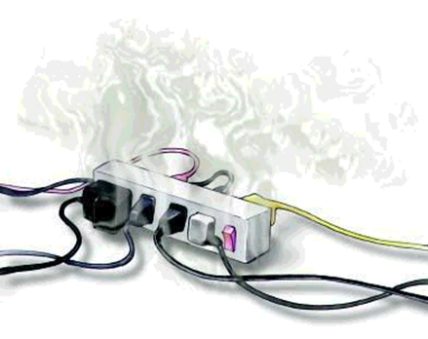
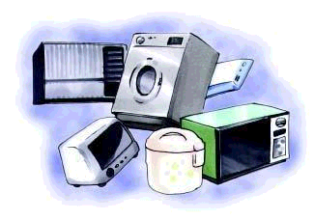


Electrical hazards (cont.)
Electrical hazards in life:
Overload current on the extension cord
Avoid high-power electric appliances sharing the same set of sockets
Incorrect usage cause damage on the wire and poor connection
http://www.klfd.gov.tw
Notes:
20160215 教學目標
說明生活中常見的錯誤用電案例

Slide 21
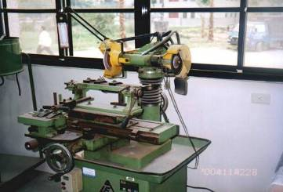
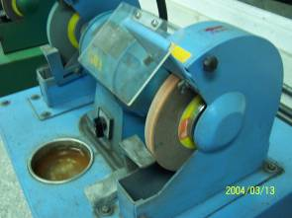
Mechanical hazards
Lack of safety cover
Definition: hazards caused by mechanical movement of mechanical parts, tools, or work pieces or injection of solid matters or liquid.
Types of laboratory mechanical hazards: including squeezing, scission, cutting, winching, trapping, impact, stabbing, friction, high-pressure liquid injection, tripping, or falling.
grinder
safety cover
safety protection for grinder
Notes:
20160215 教學目標
了解機械危害及預防
重點：說明圖片優劣之處。

Slide 22
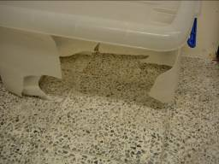
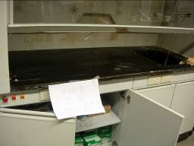
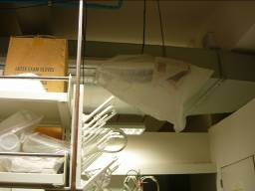
Chemical hazards
Hazardous: Poisoning or corrosion caused by contact with chemicals via inhalation, ingestion, injection or spray on skin, or other channels.
Dangerous: Disasters, such as fire and explosion, caused by energy released from chemical reaction during use of chemicals.
圖片
Notes:
20160215 教學目標
了解化學性危害及基本預防
重點提示:
所謂的化學性危害，在環境與職業衛生中的領域內，可以簡單的分為二大類：
毒性：係指物質與人體接觸後，因為它的化學性質，所引起對人體健康上的危害。
危害性：由於使用化學物質時，因管理不當或使用不慎，所引起的化學災害，例如：火災與爆炸意外。
基本預防通則：
1.減少暴露
2.管制目標：避免有害化學物質逸散至空氣中
3.自我保護
4.急性暴露的處裡處理
補充說明:
圖片說明
學生操作酸鹼中和噴濺事件
左下圖:事發當時噴濺的箱子
中下圖:事發當時噴濺至天花板及電燈
右下圖:事故發生的操作台
案例說明:某校學生將左圖的塑膠箱放置於中圖的Hood中，在其中進行酸鹼實驗(應該有使用雙氧水)，結果發生爆炸，爆炸當時Hood內設備全遭破壞(塑膠箱炸破)，實驗液體不僅濺滿Hood，亦從Hood玻璃門與操作檯面的空隙(應該就如中圖的空隙大小)往外炸出，連遠至實驗室對角斜上方電燈與天花板也遭破壞。當時室內學生一人正要從門口走出，聽到爆炸聲回頭一看，不幸遭液體噴濺眼部而受傷。

Slide 23
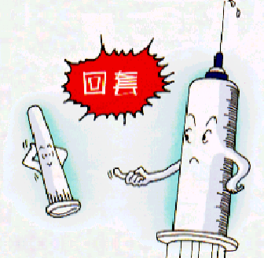
Biological hazards
Plants, animals, microorganisms, or their derivates with high potential for affecting human health or causing discomfort.
Sources: Needlestick injury, inhalation of aerosol containing pathogens deriving from mistake in handling biological specimens, or biting or scratching by pathogen-carrying experimental animals.
Types of biological hazards:
  Infection
  Allergy
  Poisoning
Re-cap
Notes:
20160215 教學目標
了解生物性危害及基本預防
重點提示:
生物性危害 Biohazards
1.感染（Infection）：生物體在人體內繁殖生長所致 ( 如：流行性感冒、痲疹、肺結核 )
2.過敏（Allergy）：生物體以過敏原角色經重覆暴露致使人體免疫系統過度反應所致 ( 如：過敏性肺炎、氣喘、過敏性鼻炎 )
3.中毒（Toxicity）：暴露於生物體所產生之毒素 （ 細菌內毒素、細菌外毒素、真菌毒素 ）所致 ( 如：發燒、發冷、肺功能受損 )
補充說明:
國內生物實驗室多半將安全衛生重點放置於預防感染，事實上生物實驗室有關的生物危害絕大部分為”過敏”類型，故進行生物實驗前最好能進行相關體質檢測，瞭解自身對哪些物質過敏(但國內很少很少這樣做)，如果沒有進行事先檢測，至少在實驗進行中要隨時注意自己是否有過敏現象，如果有過敏應立刻停止實驗，離開實驗室，尋求相關的醫療協助。

Slide 24
Types of biological hazards
Infection: caused by organisms multiplying and growing in the human body (e.g, influenza, measles, tuberculosis).
Allergy: caused by repeated exposure of an organism as an allergen to the body ’s immune system (e.g, allergic pneumonia, asthma, allergic rhinitis).
Poisoning: caused by exposure to toxins (bacterial endotoxin, bacterial exotoxin, mycotoxins) produced by organisms (e.g, fever, chills, impaired lung function)
Notes:
20160215 教學目標
了解生物性危害類別

Slide 25
Human Factors/Ergonomics Engineering
Understand environmental features, human capabilities, and restriction
Improvement of environment and tools to increase work efficiency, safety, and comfort
Fit the machine to the person！
Notes:
20160215 教學目標
了解人因工程定義
補充說明:
人因工程定義：
探討工作中人員、作業與環境之關係並達到和諧。
了解工作人員的能力、特性與作業環境所帶來的壓力，進而尋求解決改善之道。
使工作人員在其作業環境中以安全、有效、舒適的方法發揮最大績效。
人因工程運用焦點為：人員或群體在生活或工作所涉及的產品、設備和環境的交互作用上。
也就是了解人體的限制來運用人因工程，以尋求改善人們使用的器物，其使用的環境，以求更能配合人們的能力和需求。
也因此,人因工程與多方面的領域有相關,包括心理學、生理學/醫學(人體計測學；肌動學) 、人類學、生物學、力學(生物力學；流力；靜力；動力) 、數學(包括統計學) 、工程學(電子，工業管理，機械，照明) 、管理學(系統規劃)等。
實驗室人員如有人因工程上的問題，可向校內安全衛生管理單位尋求協助

Slide 26

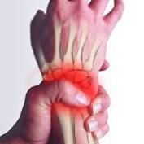
Human-factor hazards
Inadequate human-machine interface: Inadequate machine interface design leads to higher error rate or human injuries
  Computer usage
Muscle/bone injury (cumulative trauma disorder, CTD): musculoskeletal disorder injury, mostly in upper body, caused by long-term repetitive and unnatural movements
  Low back pain, carpal tunnel syndrome, tennis elbow
Human error: Erroneous movements
or damage of foolproof device caused
by such human factors as emotion,
lack of attention, and fatigue
Notes:
20160215 教學目標
了解人因工程危害
補充說明:
人機介面不良：
使用介面不良常導致失誤率增加或身體傷害的發生，電腦的使用是一個典型的人機系統的範例，滑鼠、鍵盤、螢幕、桌椅等都是人機介面，設計的好壞除了影響使用效果(效率)外，更會引起身體的一些疼痛或是傷害。
例:筆記電腦的小鍵盤相較傳統鍵盤，容易造成手腕彎曲
累積性肌肉骨骼傷害(CTD)：
會產生累積性肌肉骨骼傷害的主要成因為重覆、長時間、不自然的姿勢下收縮時，造成肌腱、腱鞘、韌帶、神經及肌肉之磨損或拉傷，通常是發生在肩膀、頸部及上肢等部位。常見的下背痛、腕隧道症候群、肌腱炎、網球肘的症狀都屬於此類問題。
人為失誤：
因為人的情緒、注意力、疲勞程度等因素造成的失誤，但其實操作者行為只是冰山的浮出部分，所以更重要的是藉由重新審視系統設計、 維修、管理制度、組織互動等不同層面的潛在影響而避免以後問題的再度產生。
大專院校實驗場所相關事故最重要之單項原因前五項為：火災爆炸(14.3%)、使用機具不當(12.3%)、使用有缺陷之機具(9.1%) 、採取不正確姿勢(8.4%)及其它(16.2%) 。高中職校實驗場所相關事故前五項最重要之單項原因為使用機具不當(40.3%)、採取不正確姿勢(20.1%)、工作中開玩笑(10.4%)、未使用防護具(8.2%)及其它(3.0%)。從這些事故發生的原因中，不乏因為缺少人因工程觀念所引起。

Slide 27
Emergency preparedness cabinets
Appropriate protective equipment should be prepared in advance for the types of laboratory experiments, equipment and experimental materials (chemical substances, etc.):
  Personal protective equipment
  Chemical absorbent
  First aid kit
Emergency preparedness equipment cabinet cannot be locked
Pay attention to the shelf life of various equipment and protective drugs
Occupational safety and health facilities regulations
27
Notes:
20160215 教學目標
認識緊急應變器材櫃
重點提示:
1.市售的通用型緊急應變器材櫃，不見得適用各種類型的實驗室，就算類型適用，其中個人防護具的尺寸也不見得符合實驗室人員(通用型緊急應變器材櫃中個人防護具尺寸通常為”for 成年男性勞工”，並不適合一般實驗室女學生，除非她特別高大)，所以除非事先確認過尺寸(或乾脆買適合自己尺寸的防護具放進去)，否則臨時從緊急應變器材櫃中拿個人防護具出來用，有因尺寸不合而使防護效果降低的風險
2.某些高級防護具，如A級防護衣，僅對受過專業訓練的緊急應變人員有用(很少很少有學校存在這樣的人員)，對一般實驗室的緊急應變器材櫃而言只是佔空間的奢侈裝飾品
補充說明:
勞工安全衛生設施規則(98.10.13)(103.7.1)
第 286 條 雇主應依工作場所之危害性，設置必要之職業災害搶救器材。

Slide 28
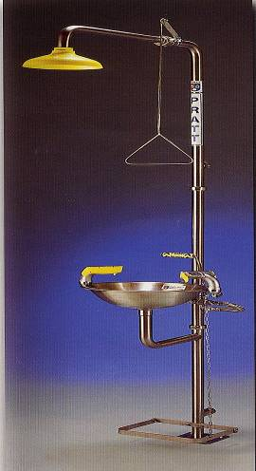
Emergency eyewash and shower device
Need to be familiar with its location and usage
The main switch cannot be closed
No debris around
Regular testing is required to confirm that the function can be used normally
Sewage collection facilities should be provided
Avoid power sockets nearby, otherwise a protective cover should be installed
Occupational safety and health facilities regulations & Specific chemical substance hazard prevention regulations
Notes:
20160215 教學目標
認識緊急洗眼沖淋裝置
補充說明:
職業安全衛生設施規則(103.7.1)
第 318 條 雇主對於勞工從事其身體或衣著有被污染之虞之特殊作業時，應置備該勞工洗眼、洗澡、漱口、更衣、洗滌等設備。前項設備，應依下列規定設置：
一、刺激物、腐蝕性物質或毒性物質污染之工作場所，每十五人應設置一個冷熱水沖淋設備。
二、刺激物、腐蝕性物質或毒性物質污染之工作場所，每五人應設置一個冷熱水盥洗設備。
特定化學物質危害預防標準(103.6.25)(105.1.30)
第 36 條 雇主使勞工從事製造、處置或使用特定化學物質時，應設置洗眼、沐浴、漱口、更衣及洗衣等設備。但丙類第一種物質或丁類物質之作業場所並應設置緊急沖淋設備。

Slide 29
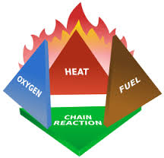
Four essential elements of fire
Fuel: Flammable substances such as wood, coal, gasoline, gas or dust reach the lower explosive limit (LEL)
Oxygen: Air is the main source of oxygen. Oxygen in oxidizing substances may also become a source of oxygen during high temperature combustion.
29
Notes:
29
20160215 教學目標
認識發生火災的因素
爆炸上限：可燃性氣體或可燃性液體之蒸氣在少量空氣下，遇熱源時可引起燃燒或爆炸之最高濃度。
爆炸下限：可燃性氣體或可燃性液體之蒸氣與空氣充分混合後，遇熱源時引起燃燒或爆炸之最低濃度。
資料來源：http://www1.cpshs.hcc.edu.tw/information/lab/safe/new_page_14.htm
http://210.59.2.4/ezcatfiles/cust/img/img/32/0018.pdf

Slide 30
Four essential elements of fire
Heat: Fuel must have a certain amount of heat to burn. The sources of heat may be open flames, electrical sparks, impact, friction, overheated objects, high-temperature surfaces, spontaneous combustion.
Chain reaction: Chain reaction dissociate the molecules to generate unstable free radicals and makes
the flame keeping burning
30
Notes:
30
20160215 教學目標
認識發生火災的因素
爆炸上限：可燃性氣體或可燃性液體之蒸氣在少量空氣下，遇熱源時可引起燃燒或爆炸之最高濃度。
爆炸下限：可燃性氣體或可燃性液體之蒸氣與空氣充分混合後，遇熱源時引起燃燒或爆炸之最低濃度。
資料來源：http://www1.cpshs.hcc.edu.tw/information/lab/safe/new_page_14.htm
http://210.59.2.4/ezcatfiles/cust/img/img/32/0018.pdf

Slide 31
Laboratory hazard
Experimenters need to understand the characteristics of their own laboratory, assess the types of disasters and human injuries that may occur, conceive of emergency procedures and prepare related equipment and drugs.
Common types of laboratory hazard:
  -Chemical leakage
  -Combustion
Get
Safety Data Sheet
Ready!!
31
Notes:
31
20160215 教學目標
認識發生火災的因素
爆炸上限：可燃性氣體或可燃性液體之蒸氣在少量空氣下，遇熱源時可引起燃燒或爆炸之最高濃度。
爆炸下限：可燃性氣體或可燃性液體之蒸氣與空氣充分混合後，遇熱源時引起燃燒或爆炸之最低濃度。
資料來源：http://www1.cpshs.hcc.edu.tw/information/lab/safe/new_page_14.htm
http://210.59.2.4/ezcatfiles/cust/img/img/32/0018.pdf

Slide 32
Laboratory hazard (cont.)
Common types of laboratory hazard to human body:
  -Skin and eye contact with chemicals
  -Inhalation and ingestion of chemicals
  -Burns
  -Frostbite
  -Induction
  -Cutting and stabbing
Get
Safety Data Sheet
Ready!!
32
Notes:
32
20160215 教學目標
認識發生火災的因素
爆炸上限：可燃性氣體或可燃性液體之蒸氣在少量空氣下，遇熱源時可引起燃燒或爆炸之最高濃度。
爆炸下限：可燃性氣體或可燃性液體之蒸氣與空氣充分混合後，遇熱源時引起燃燒或爆炸之最低濃度。
資料來源：http://www1.cpshs.hcc.edu.tw/information/lab/safe/new_page_14.htm
http://210.59.2.4/ezcatfiles/cust/img/img/32/0018.pdf

Slide 33
Chemical spill response steps
Identify the types and characteristics of chemicals
If the leakage has risk of acute poisoning or fire explosion:
  -Should evacuate immediately and seek aid
If the leakage does not cause an immediate danger:
  -If the chemical is flammable, immediately turn off all ignition sources and remove high-temperature equipment
  -If the leaked gas or liquid is volatile, should open the window immediately and notify the person in charge of the laboratory
33
Notes:
33
補充說明:
國內實驗室的化學排氣櫃與排氣扇多半不具備防爆性，可燃性化學品大量外洩時不建議開啟該類器材排氣通風，以免電氣火花引發火災。
國內曾發生過排氣櫃的開關火花引燃蒸氣，造成火災。

Slide 34
Chemical spill response steps (cont.)
If the leakage does not cause an immediate danger:
  -Wear appropriate personal protective equipment. Shut off the source of the leak and treat it with an appropriate absorbent or absorbent cotton
  -Containers containing contaminated items (e.g, used absorbent), need to consider the compatibility of materials and structural strength
34
Notes:
34
補充說明:
國內實驗室的化學排氣櫃與排氣扇多半不具備防爆性，可燃性化學品大量外洩時不建議開啟該類器材排氣通風，以免電氣火花引發火災。
國內曾發生過排氣櫃的開關火花引燃蒸氣，造成火災。

Slide 35
Fire response steps
If the fire is too large, you should evacuate immediately, turn off the main power supply, implement the emergency notification procedure, and notify the fire brigade to request assistance to extinguish the fire
If the fire has not expanded, immediately turn off the on-site combustible gas container switch and power supply, and remove the flammable materials and chemicals around as soon as possible
35

Slide 36
Fire response steps(cont.)
Confirm the type of fire and select the appropriate fire extinguisher or fire blanket to extinguish the fire
If the fire is caused by chemical leakage, try to prevent or reduce the spillage if the personnel can access it
Notify the person in charge of the laboratory and relevant units in the school
36

Slide 37
First aid for exposure to infectious substances
Situation:
  -Injures by needles or knives contaminated with infectious fluids
  -Infectious fluids contact mucous membranes or incomplete skin, or intact skin but for a long time
  -Bacterial and viral laboratory animal bites and scratches
Before the experiment, the potential hazards should be evaluated based on the biological materials and experimental procedures, and preventive measures and first aid treatment procedures
37

Slide 38
First aid for exposure to infectious substances
Treatment:
  -Squeeze the wound blood from the proximal end to the distal end
  -Clean the wound or contact area
  -Notify the laboratory manager and follow-up treatment according to the first aid procedure
38

Slide 39
Identification, evaluation, and control of laboratory hazards
Identify, evaluate, and control laboratory hazards and set up emergency response procedure, to prevent disasters and minimize damages once disaster occurs.
  Peruse and abide by laboratory safety and Health work rules.
  Understand features of hazards related to raw materials in use, machinery equipment, procedures, and environment of laboratory, evaluate their safety and health risks, and adopt proper hazard control measures.

Slide 40
Identification, evaluation, and control of laboratory hazards (cont.)
  Evaluate possible types of disasters according to laboratory features, set up emergency response procedure, prepare necessary response and first-aid equipment, and conduct drill on emergency response procedure.
Hazard prevention measures vary significantly among different types of laboratories, with common notices and measures listed below as reference

Slide 41
Laboratory safety and health work rules
According to the characteristics and content of each laboratory
Laboratory personnel must read the content thoroughly and follow it
Since the type and content of school experiments often change over time, if you find that the content of the code is no longer necessary, please cooperate with laboratory management personnel to revise the content of the rules
Occupational safety and health facilities regulations & Enforcement Rules of the Occupational Safety and Health Act

Slide 42
Hazardous chemicals
Hazardous matters (chemicals)
  Understand hazard features, level of danger and hazard, transmission channel, and grades and kinds of related preventive equipment.
    Information source: specifications on container and safety data sheet.
  Assure conformance and environment and equipment to requirements and adopt correct experimental procedure.

Slide 43
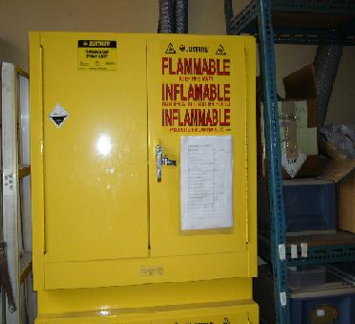
Storage of chemicals
Hazardous matters should be deposited according to their features (volatility, inflammability, and compatibility).
Exhaust facilities of place for deposit of hazardous matters should be checked and maintained regularly.
Place with deposit of massive volatile and inflammable liquid should be furnished with inflammable-gas detectors, which be checked regularly to assure their normal operation.
Ventilation and exhaust
Fireproof explosion-proof cabinet
Occupational safety and health facilities regulations & Regulation of Prevention for. Organic Solvent Poisoning
Notes:
43
補充說明:
防火防爆櫃裝設之連動排氣設施需要定期檢查與維護。
裝設化學物質之洩漏警報器時，應針對所儲存的化學物質的種類與特性（如爆炸上下限）選擇合適的設備。
職業安全衛生設施規則(103.7.1)
第 177 條 雇主對於作業場所有易燃液體之蒸氣、可燃性氣體或爆燃性粉塵以外之可燃性粉塵滯留，而有爆炸、火災之虞者，應依危險特性採取通風、換氣、除塵等措施外，並依下列規定辦理：
一、指定專人對於前述蒸氣、氣體之濃度，於作業前測定之。
二、蒸氣或氣體之濃度達爆炸下限值之百分之三十以上時，應即刻使勞工退避至安全場所，並停止使用煙火及其他為點火源之虞之機具，並應加強通風。
三、使用之電氣機械、器具或設備，應具有適合於其設置場所危險區域劃分使用之防爆性能構造。
前項第三款所稱電氣機械、器具或設備，係指包括電動機、變壓器、連接裝置、開關、分電盤、配電盤等電流流通之機械、器具或設備及非屬配線或移動電線之其他類似設備。
第 177-1 條 雇主對於有爆燃性粉塵存在，而有爆炸、火災之虞之場所，使用之電氣機械、器具或設備，應具有適合於其設置場所危險區域劃分使用之防爆性能構造。
第 184 條 雇主對於危險物製造、處置之工作場所，為防止爆炸、火災，應依下列規定辦理：
一、爆炸性物質，應遠離煙火、或有發火源之虞之物，並不得加熱、摩擦、衝擊。
二、著火性物質，應遠離煙火、或有發火源之虞之物，並不得加熱、摩擦或衝擊或使其接觸促進氧化之物質或水。
三、氧化性物質，不得使其接觸促進其分解之物質，並不得予以加熱、摩擦或撞擊。
四、易燃液體，應遠離煙火或有發火源之虞之物，未經許可不得灌注、蒸發或加熱。
五、除製造、處置必需之用料外，不得任意放置危險物。
第 191 條 雇主對於異類物品接觸有引起爆炸、火災、危險之虞者，應單獨儲放，搬運時應使用專用之運搬機械。但經採取防止接觸之設施者，不在此限。
有機溶劑中毒預防規則(103.6.25)
第 25 條 雇主於室內儲藏有機溶劑或其混存物時，應使用備有栓蓋之堅固容器，以免有機溶劑或其混存物之溢出、漏洩、滲洩或擴散，該儲藏場所應依下列規定：
一、防止與作業無關人員進入之措施。
二、將有機溶劑蒸氣排除於室外。

Slide 44
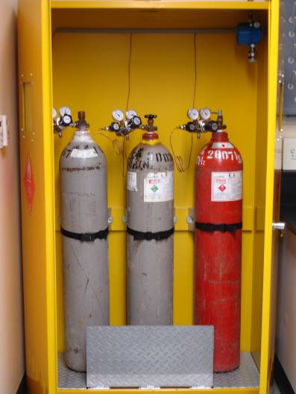
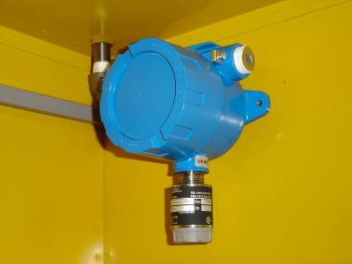
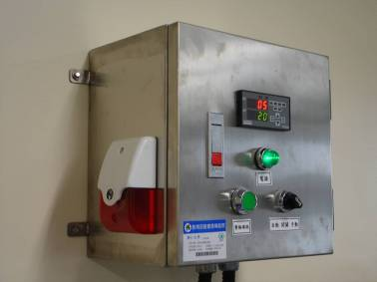
Fire and explosion-proof cabinet for storing hydrogen cylinders
Hydrogen detector
Alarm device
supplement
Occupational safety and health facilities regulations
Notes:
44
補充說明:
可燃性高壓氣體儲存場所，應設有可對應該氣體的洩漏偵測與警報設備。
如儲存的化學物質為單一種類物質（如氫氣），則應裝設該物質的專用偵測器（如氫氣外洩偵測器）。
通用型的偵測器（如可燃性氣體偵測器），應使用在儲存多種、不特定種類物質（如廢液儲存場）的場所。
注意各種警報器會發出警報時之外洩濃度間的差異。
職業安全衛生設施規則(103.7.1)
第 197 條 雇主對於化學設備或其附屬設備，為防止因爆炸、火災、洩漏等造成勞工之危害，應採取下列措施：
一、確定為輸送原料、材料於化學設備或自該等設備卸收產品之有關閥、旋塞等之正常操作。
二、確定冷卻、加熱、攪拌及壓縮等裝置之正常操作。
三、保持溫度計、壓力計或其他計測裝置於正常操作功能。
四、保持安全閥、緊急遮斷裝置、自動警報裝置或其他安全裝置於異常狀態時之有效運轉。

Slide 45
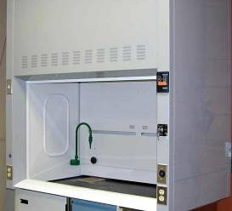
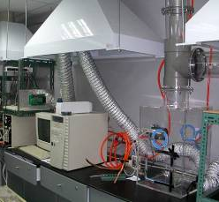
Ventilation equipment
Maintain good ventilation in laboratory.
Volatile chemicals should be handled inside chemical hood.
Handle microorganism with air-born transmission capability inside a biological safety hood.
Don't mix chemical exhaust tank with biological safe air tank, which has different function and structure.
Don't place superfluous matters inside chemical exhaust tank to avoid blockage of air flow.
Chemical exhaust tank
Occupational safety and health facilities regulations, Regulation of Prevention for. Organic Solvent Poisoning and Specified Chemical Substances Hazard Prevention Standards
Partial exhaust device
Notes:
45
補充說明:
儀器於操作中可能排放有毒氣體，例:氣相層析儀的分流口
職業安全衛生設施規則(103.7.1)
第 292 條 雇主對於有害氣體、蒸氣、粉塵等作業場所，應依下列規定辦理：
一、工作場所內發散有害氣體、蒸氣、粉塵時，應視其性質，採取密閉設
備、局部排氣裝置、整體換氣裝置或以其他方法導入新鮮空氣等適當
措施，使其不超過勞工作業場所容許暴露標準之規定。勞工有發生中
毒之虞者，應停止作業並採取緊急措施。
二、勞工暴露於有害氣體、蒸氣、粉塵等之作業時，其空氣中濃度超過八
小時日時量平均容許濃度、短時間時量平均容許濃度或最高容許濃度
者，應改善其作業方法、縮短工作時間或採取其他保護措施。
三、有害物工作場所，應依有機溶劑、鉛、四烷基鉛、粉塵及特定化學物
質等有害物危害預防法規之規定，設置通風設備，並使其有效運轉。
有機溶劑中毒預防規則(103.6.25)
第 6 條 雇主使勞工於下列規定之作業場所作業，應依下列規定，設置必要之控制設備：
一、於室內作業場所或儲槽等之作業場所，從事有關第一種有機溶劑或其
混存物之作業，應於設置密閉設備或局部排氣裝置。
二、於室內作業場所或儲槽等之作業場所，從事有關第二種有機溶劑或其
混存物之作業，應於各該作業場所設置密閉設備、局部排氣裝置或整
體換氣裝置。
三、於儲槽等之作業場所或通風不充分之室內作業場所，從事有關第三種
有機溶劑或其混存物之作業，應於各該作業場所設置密閉設備、局部
排氣裝置或整體換氣裝置。
前項控制設備，應依有機溶劑之健康危害分類、散布狀況及使用量等情形
，評估風險等級，並依風險等級選擇有效之控制設備。
第一項各款對於從事第二條第十二款及同項第二款、第三款對於以噴布方
式從事第二條第四款至第六款、第八款或第九款規定之作業者，不適用之
。
第 12 條 雇主設置之局部排氣裝置之氣罩及導管，應依下列之規定：
一、氣罩應設置於每一有機溶劑蒸氣發生源。
二、外裝型氣罩應儘量接近有機溶劑蒸氣發生源。
三、氣罩應視作業方法、有機溶劑蒸氣之擴散狀況及有機溶劑之比重等，選擇適於吸引該有機溶劑蒸氣之型式及大小。
四、應儘量縮短導管長度、減少彎曲數目，且應於適當處所設置易於清掃之清潔口與測定孔。
特定化學物質危害預防標準(103.6.25)(105.1.30)
第 8 條 前條核定基準如下：雇主使勞工從事試驗或研究甲類物質時，應依下列規定辦理：
一、製造設備應為密閉設備。但在作業性質上設置該項設備顯有困難，而
將其置於氣櫃內者，不在此限。
二、設置製造設備場所之地板及牆壁應以不浸透性材料構築，且應為易於
用水清洗之構造。
三、從事製造或使用甲類物質者，應具有預防該物質引起危害健康之必要
知識。
四、儲存甲類物質時，應採用不漏洩、不溢出等之堅固容器，並應依危險
性化學品標示及通識規則規定予以標示。
五、甲類物質應保管於一定之場所，並將其意旨揭示於顯明易見之處。
六、供給從事製造或使用甲類物質之勞工使用不浸透性防護圍巾及防護手
套等個人防護具。
七、製造場所應禁止與該作業無關之人員進入，並將其意旨揭示於顯明易
見之處。
第 13 條 雇主使勞工處置、使用乙類物質，將乙類物質投入容器、自容器取出或投入反應槽等之作業時，應於該作業場所設置可密閉各該物質之氣體、蒸氣或粉塵發生源之密閉設備或使用包圍型氣罩之局部排氣裝置。
例:乙類物質，如三氯甲苯，及含有三氯甲苯占其重量超過百分之○．五之混合物
第 16 條 雇主對散布有丙類第一種物質或丙類第三種物質之氣體、蒸氣或粉塵之室內作業場所，應於各該發生源設置密閉設備或局部排氣裝置。但設置該項設備顯有困難或為臨時性作業者，不在此限。
依前項但書規定未設密閉設備或局部排氣裝置時，應設整體換氣裝置或將各該物質充分濕潤成泥狀或溶解於溶劑中者，危害勞工健康之程度者。
例:丙類第一種物質，硫化氫，含有硫化氫占其重量超過百分之一之混合物
第 16-1 條 第十三條、第十四條及前條應設置之控制設備，應依特定化學物質之健康危害分類、散布狀況及使用量等情形，評估風險等級，並依風險等級選擇有效之控制設備。
第 17 條 雇主依本標準規定設置之局部排氣裝置，依下列規定：
一、氣罩應置於每一氣體、蒸氣或粉塵發生源；如為外裝型或接受型之氣罩，則應接近各該發生源設置。
二、應儘量縮短導管長度、減少彎曲數目，且應於適當處所設置易於清掃之清潔口與測定孔。
三、設置有除塵裝置或廢氣處理裝置者，其排氣機應置於各該裝置之後。
但所吸引之氣體、蒸氣或粉塵無爆炸之虞且不致腐蝕該排氣機者，不在此限。
四、排氣口應置於室外。
五、於製造或處置特定化學物質之作業時間內有效運轉，降低空氣中有害物濃度。
第 47 條 雇主不得使勞工從事以苯等為溶劑之作業。但作業設備為密閉設備或採用不使勞工直接與苯等接觸並設置包圍型局部排氣裝置者，不在此限。
職業安全衛生設施規則(103.7.1)
第 297-1 條 雇主對於工作場所有生物病原體危害之虞者，應採取下列感染預防措施：
一、危害暴露範圍之確認。
二、相關機械、設備、器具等之管理及檢點。
三、警告傳達及標示。
四、健康管理。
五、感染預防作業標準。
六、感染預防教育訓練。
七、扎傷事故之防治。
八、個人防護具之採購、管理及配戴演練。
九、緊急應變。
十、感染事故之報告、調查、評估、統計、追蹤、隱私權維護及紀錄。
十一、感染預防之績效檢討及修正。
十二、其他經中央主管機關指定者。
前項預防措施於醫療保健服務業，應增列勞工工作前預防感染之預防注射等事項。
前二項之預防措施，應依作業環境特性，訂定實施計畫及將執行紀錄留存三年，於僱用勞工人數在三十人以下之事業單位，得以執行紀錄或文件代替。

Slide 46
Ventilation equipment (cont.)
If operation of equipment may emit poisonous gas, connect drain to partial exhaust device.
Check partial exhaust device and hood regularly (once annually, according to autonomous check measures) (such as for sufficiency of control wind speed)
Stop experiment and seek help for repairing exhaust system, in case there occur following situations for the system:
  damage of exhaust pipes
  abnormal rotation speed of motor
  blockage of filtering device
  other possible abnormal symptoms (such as noise)
Occupational safety and health facilities regulations, Regulation of Prevention for. Organic Solvent Poisoning and Specified Chemical Substances Hazard Prevention Standards
Notes:
46
重點提示:
1.必須養成在通風櫥、通氣櫃或有局部排氣設備裝置等場所使用操作毒性物質的良好習慣！
2.排氣櫃等局部排氣裝置依職業安全衛生管理辦法 (103.06.26)(105.2.29)須每年進行詳細檢驗(項目請見下方法條)，但在各校自訂的實驗室自動檢查規定中，簡單的檢查可能是每半年或每個月一次，也有學校規定需每日檢查，請同學依照自己學校的規定辦理。
補充說明:
原有的投影片內容
設置之密閉設備、局部排氣裝置或整體換氣裝置，應由專業人員設計，並維持其性能。
局部排氣裝置、空氣清淨裝置及吹吸型換氣裝置應每年定期實施檢查。
通風系統性能檢點 -- 外觀（灰塵，馬達轉速，破損脫落，性能（風速，壓力損失）。
通風系統定期維護 -- 通風管道阻塞，污染防制設備失效，損壞修護。
特定化學物質危害預防標準(103.6.25)(105.1.30)
第 38 條 雇主設置之密閉設備、局部排氣裝置或整體換氣裝置，應由專業人員妥為設計，並維持其性能。
有機溶劑中毒預防規則(103.6.25)
第 17 條 雇主設置之密閉設備、局部排氣裝置、吹吸型換氣裝置或整體換氣裝置，應由專業人員妥為設計，並維持其有效性能
職業安全衛生管理辦法 (103.06.26)(105.2.19)
第 40 條 雇主對局部排氣裝置、空氣清淨裝置及吹吸型換氣裝置應每年依下列規定定期實施檢查一次：
一、氣罩、導管及排氣機之磨損、腐蝕、凹凸及其他損害之狀況及程度。
二、導管或排氣機之塵埃聚積狀況。
三、排氣機之注油潤滑狀況。
四、導管接觸部分之狀況。
五、連接電動機與排氣機之皮帶之鬆弛狀況。
六、吸氣及排氣之能力。
七、設置於排放導管上之採樣設施是否牢固、鏽蝕、損壞、崩塌或其他妨礙作業安全事項。
八、其他保持性能之必要事項。
第 41 條 雇主對設置於局部排氣裝置內之空氣清淨裝置，應每年依下列規定定期實施檢查一次：
一、構造部分之磨損、腐蝕及其他損壞之狀況及程度。
二、除塵裝置內部塵埃堆積之狀況。
三、濾布式除塵裝置者，有濾布之破損及安裝部分鬆弛之狀況。
四、其他保持性能之必要措施。
通風系統性能檢點--外觀（灰塵，馬達轉速，破損脫落，性能（風速，壓力損失）。
通風系統定期維護--通風管道阻塞，污染防制設備失效，損壞修護。

Slide 47
Machinery equipment
Understand features of hazards related to operation of various laboratory equipment (high temperature, percussion, noise, optical-energy injury, ionizing radiation), operating method, functions of various components, and significance of interface signals.
  Information source: instructions of instruments and equipment
Correct operation and maintenance
In case abnormal situation appears, stop operation instantly.

Slide 48
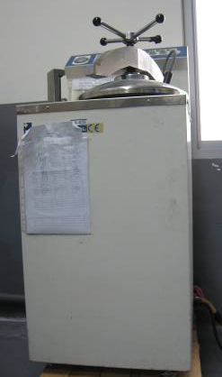
Pressure container
Major points of notice for pressure containers (such as high-temperature, high-pressure sterilizer, air tank of air compressor):
  Whether or not there is damage or deformation in case or interior?
  Whether or not there is abnormality in the operation of container gate and packing device?
high-pressure sterilizer
Occupational Safety and Health Management Measures
Notes:
48
補充說明:
依照下列條文，壓力容器主要分為三種，第一種壓力容器(不包含小型壓力容器)-例:大型高溫高壓滅菌鍋；第二種壓力容器-例:空氣壓縮機的空氣儲瓶；小型壓力容器-例:小型高溫高壓滅菌鍋 (以上舉例為一般狀況，實際確實分類要視壓力、容積而定)
鍋爐及壓力容器安全規則(103.7.1)
第 4 條 本規則所稱壓力容器，分為下列二種：
一、第一種壓力容器，指合於下列規定之一者：
（一）接受外來之蒸汽或其他熱媒或使在容器內產生蒸氣加熱固體或液體之容器，且容器內之壓力超過大氣壓。
（二）因容器內之化學反應、核子反應或其他反應而產生蒸氣之容器，且容器內之壓力超過大氣壓。
（三）為分離容器內之液體成分而加熱該液體，使產生蒸氣之容器，且容器內之壓力超過大氣壓。
（四）除前三目外，保存溫度超過其在大氣壓下沸點之液體之容器。
二、第二種壓力容器，指內存氣體之壓力在每平方公分二公斤以上或零點二百萬帕斯卡（MPa） 以上之容器而合於下列規定之一者：
（一）內容積在零點零四立方公尺以上之容器。
（二）胴體內徑在二百毫米以上，長度在一千毫米以上之容器。
前項壓力容器如屬高壓氣體特定設備、高壓氣體容器或高壓氣體設備，應依高壓氣體安全相關法規辦理。
第 5 條 本規則所稱小型壓力容器，指第一種壓力容器合於下列規定之一者：
一、最高使用壓力在每平方公分一公斤以下或零點一百萬帕斯卡（MPa）以下，且內容積在零點二立方公尺以下。
二、最高使用壓力在每平方公分一公斤以下或零點一百萬帕斯卡（MPa）以下，且胴體內徑在五百毫米以下，長度在一千毫米以下。
三、以「每平方公分之公斤數」單位所表示之最高使用壓力數值與以「立方公尺」單位所表示之內容積數值之乘積在零點二以下，或以「百萬帕斯卡（MPa）」 單位所表示之最高使用壓力數值與以「立方公尺」單位所表示之內容積數值之乘積在零點零二以下。
職業安全衛生管理辦法 (103.06.26)(105.2.19)
第 33 條 雇主對高壓氣體特定設備、高壓氣體容器及第一種壓力容器應每月依下列規定定期實施檢查一次：
一、本體有無損傷、變形。
二、蓋板螺栓有無損耗。
三、管及閥等有無損傷、洩漏。
四、壓力表及溫度計及其他安全裝置有無損傷。
五、平台支架有無嚴重腐蝕。
對於有保溫部分或有高游離輻射污染之虞之場所，得免實施。
第 35 條 雇主對第二種壓力容器應每年依下列規定定期實施檢查一次：
一、內面及外面有無顯著損傷、裂痕、變形及腐蝕。
二、蓋、凸緣、閥、旋塞等有無異常。
三、安全閥、壓力表與其他安全裝置之性能有無異常。
四、其他保持性能之必要事項。
第 36 條 雇主對小型壓力容器應每年依下列規定定期實施檢查一次：
一、本體有無損傷。
二、蓋板螺旋有無異常。
三、管及閥等有無異常。
四、其他保持性能之必要事項。
第 45 條 雇主對第二種壓力容器應於初次使用前依下列規定實施重點檢查：
一、確認胴體、端板之厚度是否與製造廠所附資料符合。
二、確認安全閥吹洩量是否足夠。
三、各項尺寸、附屬品與附屬裝置是否與容器明細表符合。
四、經實施耐壓試驗無局部性之膨出、伸長或洩漏之缺陷。
五、其他保持性能之必要事項。

Slide 49
Pressure container (cont.)
  Whether or not there is abnormality in the function of safety valve, pressure gauge, and other safety devices?
  Whether or not there is damage in pressure gauge, thermometer, and other safety devices?
high-pressure sterilizer
Occupational Safety and Health Management Measures
Notes:
49
補充說明:
依照下列條文，壓力容器主要分為三種，第一種壓力容器(不包含小型壓力容器)-例:大型高溫高壓滅菌鍋；第二種壓力容器-例:空氣壓縮機的空氣儲瓶；小型壓力容器-例:小型高溫高壓滅菌鍋 (以上舉例為一般狀況，實際確實分類要視壓力、容積而定)
鍋爐及壓力容器安全規則(103.7.1)
第 4 條 本規則所稱壓力容器，分為下列二種：
一、第一種壓力容器，指合於下列規定之一者：
（一）接受外來之蒸汽或其他熱媒或使在容器內產生蒸氣加熱固體或液體之容器，且容器內之壓力超過大氣壓。
（二）因容器內之化學反應、核子反應或其他反應而產生蒸氣之容器，且容器內之壓力超過大氣壓。
（三）為分離容器內之液體成分而加熱該液體，使產生蒸氣之容器，且容器內之壓力超過大氣壓。
（四）除前三目外，保存溫度超過其在大氣壓下沸點之液體之容器。
二、第二種壓力容器，指內存氣體之壓力在每平方公分二公斤以上或零點二百萬帕斯卡（MPa） 以上之容器而合於下列規定之一者：
（一）內容積在零點零四立方公尺以上之容器。
（二）胴體內徑在二百毫米以上，長度在一千毫米以上之容器。
前項壓力容器如屬高壓氣體特定設備、高壓氣體容器或高壓氣體設備，應依高壓氣體安全相關法規辦理。
第 5 條 本規則所稱小型壓力容器，指第一種壓力容器合於下列規定之一者：
一、最高使用壓力在每平方公分一公斤以下或零點一百萬帕斯卡（MPa）以下，且內容積在零點二立方公尺以下。
二、最高使用壓力在每平方公分一公斤以下或零點一百萬帕斯卡（MPa）以下，且胴體內徑在五百毫米以下，長度在一千毫米以下。
三、以「每平方公分之公斤數」單位所表示之最高使用壓力數值與以「立方公尺」單位所表示之內容積數值之乘積在零點二以下，或以「百萬帕斯卡（MPa）」 單位所表示之最高使用壓力數值與以「立方公尺」單位所表示之內容積數值之乘積在零點零二以下。
職業安全衛生管理辦法 (103.06.26)(105.2.19)
第 33 條 雇主對高壓氣體特定設備、高壓氣體容器及第一種壓力容器應每月依下列規定定期實施檢查一次：
一、本體有無損傷、變形。
二、蓋板螺栓有無損耗。
三、管及閥等有無損傷、洩漏。
四、壓力表及溫度計及其他安全裝置有無損傷。
五、平台支架有無嚴重腐蝕。
對於有保溫部分或有高游離輻射污染之虞之場所，得免實施。
第 35 條 雇主對第二種壓力容器應每年依下列規定定期實施檢查一次：
一、內面及外面有無顯著損傷、裂痕、變形及腐蝕。
二、蓋、凸緣、閥、旋塞等有無異常。
三、安全閥、壓力表與其他安全裝置之性能有無異常。
四、其他保持性能之必要事項。
第 36 條 雇主對小型壓力容器應每年依下列規定定期實施檢查一次：
一、本體有無損傷。
二、蓋板螺旋有無異常。
三、管及閥等有無異常。
四、其他保持性能之必要事項。
第 45 條 雇主對第二種壓力容器應於初次使用前依下列規定實施重點檢查：
一、確認胴體、端板之厚度是否與製造廠所附資料符合。
二、確認安全閥吹洩量是否足夠。
三、各項尺寸、附屬品與附屬裝置是否與容器明細表符合。
四、經實施耐壓試驗無局部性之膨出、伸長或洩漏之缺陷。
五、其他保持性能之必要事項。

Slide 50
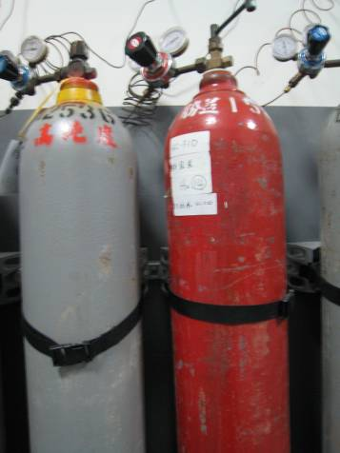
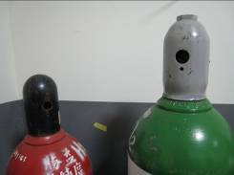
High-pressure gas container
(such as steel gas cylinder)
Major points of notice for steel gas cylinder
  Whether or not horizontal support for high-pressure gas cylinder is fixed?
  Whether or not pressures of various gauges are normal?
  Where or not there are inflammable materials in the storage space for steel cylinder?
Wrench shouldn't be put on the switch of steel cylinder
Steel cylinder
needs to be fixed
Spare cylinder and empty cylinder should be furnished with cap
Occupational safety and health facilities regulations &
Occupational Safety and Health Management Measures
Notes:
50
補充說明:
一般常見的氣體鋼瓶因內裝高壓氣體，是高壓氣體容器，適用下列”職業安全衛生設施規則“ 中的規定
但因容積小於0.5立方公尺(危險性機械及設備安全檢查規則第4條)，因此並不是”危險性機械及設備安全檢查規則“適用的高壓氣體容器。。
職業安全衛生設施規則(103.7.1)
第 106 條 雇主對於高壓氣體容器，不論盛裝或空容器，使用時，應依下列規定辦理：
一、確知容器之用途無誤者，方得使用。
二、高壓氣體容器應標明所裝氣體之品名，不得任意灌裝或轉裝。
三、容器外表顏色，不得擅自變更或擦掉。
四、容器使用時應加固定。
五、容器搬動不得粗莽或使之衝擊。
六、焊接時不得在容器上試焊。
七、容器應妥善管理、整理。
第 107 條 雇主對於高壓氣體容器，不論盛裝或空容器，搬運時，應依下列規定辦理：
一、溫度保持在攝氏四十度以下。
二、場內移動儘量使用專用手推車等，務求安穩直立。
三、以手移動容器，應確知護蓋旋緊後，方直立移動。
四、容器吊起搬運不得直接用電磁鐵，吊鏈、繩子等直接吊運。
五、容器裝車或卸車，應確知護蓋旋緊後才進行，卸車時必須使用緩衝板或輪胎。
六、儘量避免與其他氣體混載，非混載不可時，應將容器之頭尾反方向置放或隔置相當間隔。
七、載運可燃性氣體時，要置備滅火器；載運毒性氣體時，要置備吸收劑、中和劑、防毒面具等。
八、盛裝容器之載運車輛，應有警戒標誌。
九、運送中遇有漏氣，應檢查漏出部位，給予適當處理。
十、搬運中發現溫度異常高昇時，應立即灑水冷卻，必要時，並應通知原製造廠協助處理。
第 108 條 雇主對於高壓氣體之貯存，應依下列規定辦理：
一、貯存場所應有適當之警戒標示，禁止煙火接近。
二、貯存周圍二公尺內不得放置有煙火及著火性、引火性物品。
三、盛裝容器和空容器應分區放置。
四、可燃性氣體、有毒性氣體及氧氣之鋼瓶，應分開貯存。
五、應安穩置放並加固定及裝妥護蓋。
六、容器應保持在攝氏四十度以下。
七、貯存處應考慮於緊急時便於搬出。
八、通路面積以確保貯存處面積百分之二十以上為原則。
九、貯存處附近，不得任意放置其他物品。
十、貯存比空氣重之氣體，應注意低漥處之通風。
職業安全衛生管理辦法 (103.06.26)(105.2.19)
第 33 條 雇主對高壓氣體特定設備、高壓氣體容器及第一種壓力容器應每月依下列規定定期實施檢查 一次：
一、本體有無損傷、變形。
二、蓋板螺栓有無損耗。
三、管及閥等有無損傷、洩漏。
四、壓力表及溫度計及其他安全裝置有無損傷。
五、平台支架有無嚴重腐蝕。
對於有保溫部分或有高游離輻射污染之虞之場所，得免實施。
第 64 條 雇主使勞工從事下列危險性設備作業時，應使該勞工就其作業有關事項實施檢點：
一、鍋爐之操作作業。
二、第一種壓力容器之操作作業。
三、高壓氣體特定設備之操作作業。
四、高壓氣體容器之操作作業。

Slide 51
High-pressure gas container
(such as steel gas cylinder) (cont.)
  Whether or not there are clear description of constituents of various steel cylinders?
  Whether or not there is leakage in connector?
  Whether or not temperature in storage space of steel cylinders exceeds 40°C?
Wrench shouldn't be put on the switch of steel cylinder
Steel cylinder needs to be fixed
Spare cylinder and empty cylinder should be furnished with cap
Occupational safety and health facilities regulations &
Occupational Safety and Health Management Measures
Notes:
51
補充說明:
一般常見的氣體鋼瓶因內裝高壓氣體，是高壓氣體容器，適用下列”職業安全衛生設施規則“ 中的規定
但因容積小於0.5立方公尺(危險性機械及設備安全檢查規則第4條)，因此並不是”危險性機械及設備安全檢查規則“適用的高壓氣體容器。。
職業安全衛生設施規則(103.7.1)
第 106 條 雇主對於高壓氣體容器，不論盛裝或空容器，使用時，應依下列規定辦理：
一、確知容器之用途無誤者，方得使用。
二、高壓氣體容器應標明所裝氣體之品名，不得任意灌裝或轉裝。
三、容器外表顏色，不得擅自變更或擦掉。
四、容器使用時應加固定。
五、容器搬動不得粗莽或使之衝擊。
六、焊接時不得在容器上試焊。
七、容器應妥善管理、整理。
第 107 條 雇主對於高壓氣體容器，不論盛裝或空容器，搬運時，應依下列規定辦理：
一、溫度保持在攝氏四十度以下。
二、場內移動儘量使用專用手推車等，務求安穩直立。
三、以手移動容器，應確知護蓋旋緊後，方直立移動。
四、容器吊起搬運不得直接用電磁鐵，吊鏈、繩子等直接吊運。
五、容器裝車或卸車，應確知護蓋旋緊後才進行，卸車時必須使用緩衝板或輪胎。
六、儘量避免與其他氣體混載，非混載不可時，應將容器之頭尾反方向置放或隔置相當間隔。
七、載運可燃性氣體時，要置備滅火器；載運毒性氣體時，要置備吸收劑、中和劑、防毒面具等。
八、盛裝容器之載運車輛，應有警戒標誌。
九、運送中遇有漏氣，應檢查漏出部位，給予適當處理。
十、搬運中發現溫度異常高昇時，應立即灑水冷卻，必要時，並應通知原製造廠協助處理。
第 108 條 雇主對於高壓氣體之貯存，應依下列規定辦理：
一、貯存場所應有適當之警戒標示，禁止煙火接近。
二、貯存周圍二公尺內不得放置有煙火及著火性、引火性物品。
三、盛裝容器和空容器應分區放置。
四、可燃性氣體、有毒性氣體及氧氣之鋼瓶，應分開貯存。
五、應安穩置放並加固定及裝妥護蓋。
六、容器應保持在攝氏四十度以下。
七、貯存處應考慮於緊急時便於搬出。
八、通路面積以確保貯存處面積百分之二十以上為原則。
九、貯存處附近，不得任意放置其他物品。
十、貯存比空氣重之氣體，應注意低漥處之通風。
職業安全衛生管理辦法 (103.06.26)(105.2.19)
第 33 條 雇主對高壓氣體特定設備、高壓氣體容器及第一種壓力容器應每月依下列規定定期實施檢查 一次：
一、本體有無損傷、變形。
二、蓋板螺栓有無損耗。
三、管及閥等有無損傷、洩漏。
四、壓力表及溫度計及其他安全裝置有無損傷。
五、平台支架有無嚴重腐蝕。
對於有保溫部分或有高游離輻射污染之虞之場所，得免實施。
第 64 條 雇主使勞工從事下列危險性設備作業時，應使該勞工就其作業有關事項實施檢點：
一、鍋爐之操作作業。
二、第一種壓力容器之操作作業。
三、高壓氣體特定設備之操作作業。
四、高壓氣體容器之操作作業。

Slide 52

Toxic chemicals
Package of containers for toxic chemicals should bear specifications as mandated and safety data sheet (SDS) for the chemicals.
There should be sign "handling premises of toxic chemicals" at the entry/outlet of handling site.
Maintain normal operation of anti-emission or -leakage facilities during the handling of toxic chemicals and prepare emergency response equipment.
Materials Safety Data Sheets for Toxic and Concerned Chemical Substances & Categories and Management of Handling for Toxic Chemical Substance
Notes:
52
重點提示:
1.運作場所需於出入口標示「毒性化學物質運作場所（Handling Premises of Toxic Chemicals）」字樣：這部份出入口標示字樣規定是毒化物專屬的，普通的危害物質沒有像”危害物質運作場所”這樣的強制標示規定
補充說明:
學術機構運作毒性化學物質管理辦法(101.12.20)
第 8 條 學術機構毒性化學物質容器、包裝或其運作單位及設施之標示，應依毒性化學物質標示及安全資料表管理辦法規定辦理。
前項容器之容積在一百毫升以下者，得僅標示名稱、危害圖式及警示語。
毒性化學物質標示及安全資料表管理辦法(103.11.10)
第3條
毒性化學物質之容器、包裝，應符合中華民國國家標準（CNS） 一五○三○所定分類、標示要項並依附表格式明顯標示下列事項：
一、危害圖式：直立四十五度角之白底紅色粗框正方形，內為黑色象徵符號，大小以能辨識清楚為度。
二、內容：
（一）名稱。
（二）危害成分：所含毒性化學物質達管制濃度以上之成分，應以中央主管機關公告之名稱（中英文）標示，並加註毒性化學物質等字樣及所含毒性化學物質重量百分比（w/w） 。
（三）警示語。
（四）危害警告訊息：訊息內容應符合中華民國國家標準（CNS） 一五○三○所列各項危害特性。
（五）危害防範措施：依危害物特性採行污染防制措施。
（六）製造者、輸入者或供應者之名稱、地址及電話：供應商即輸入毒性化學物質之運作人。
前項標示如其危害物質不符合中華民國國家標準（CNS） 一五○三○規定之分類歸類者，得僅標示前項第二款事項。
第一項容器、包裝容積在一百毫升以下者，得僅標示名稱、危害圖式及警示語。
第 4 條
製造、輸入毒性化學物質之運作人，應逐一標示其容器、包裝。買受毒性化學物質之運作人，應維持標示內容清晰、完整。
第 5 條
自行使用所分裝、調配毒性化學物質之容器、包裝，使用人應依第三條規定標示。
前項於同一處所以數個容器、包裝裝盛相同毒性化學物質者，得於明顯處依第九條規定設置公告板代替容器、包裝標示。
第 6 條
毒性化學物質之容器、包裝有下列情形之一者，得免依第三條規定標示：
一、外部容器、包裝已標示，僅供內襯且不再取出之內部容器、包裝。
二、內部容器、包裝已標示，由外部可見到清晰標示事項之外部容器、包裝。
三、毒性化學物質取自有標示之容器、包裝，且僅供當班立即使用。
四、毒性化學物質取自有標示之容器、包裝，並供實驗室自行作實驗、研究之用。
第 9 條
毒性化學物質之運作場所及設施，應於明顯易見處所以公告板摘要標示下列事項：
一、第三條第一項規定之危害圖式、名稱、危害成分及警示語。
二、危害警告訊息：訊息內容應符合中華民國國家標準（CNS） 一五○三○所列各項危害特性，含毒理特性說明及避免吸入、食入或皮膚直接接觸之警語。
三、危害防範措施：含中毒急救方法、污染防制措施及緊急處理方法、警報發布方法、防火或其他防災器材之使用規定、人員動員搶救之規定及對緊急應變所應採取之通知方式。
同一運作場所運作多種毒性化學物質者，得於同一公告板書寫各項標示內容；前項第二款及第三款之各項內容如有相同者，得合併書寫。
第 10 條
毒性化學物質之運作場所及設施有下列情形之一者，得免依前條規定標示：
一、經依本法第十三條第三項規定申請廢棄登記之毒性化學物質其暫存場所。
二、暫時放置海運、空運裝卸不特定毒性化學物質倉庫，已標示危險品倉庫（Dangerous Goods Storage） 等字樣。
三、僅供試驗、研究、教育用途且運作量低於大量運作基準，於運作場所各出入地點已標示毒性化學物質運作場所（Handling Premises of Toxic Chemicals） 等字樣。
第 12 條
製造、輸入毒性化學物質之運作人，應依中央主管機關規定格式製作安全資料表，並應隨時檢討安全資料表內容之正確性。其更新內容、更新日期、版次等紀錄應保存三年備查。
前項安全資料表之緊急聯絡電話應為任一時刻均可聯絡並接受事故應變諮詢之電話。
第 17 條
毒性化學物質運作人應將安全資料表置於運作場所中易取得之處。
列管毒性化學物質及其運作管理事項(102.01.24)(106.9.26)
六八、貯存毒性化學物質應採用不排放、不洩漏之密閉式堅固容器、包裝，並置於陰涼乾燥處所，貯存場所應有專人妥善管理。

Slide 53
Toxic chemicals (cont.)
Deposit toxic chemicals in airtight solid container and package which should be placed in storage site with good management.
  Place for deposit of toxins should be locked.
Check, maintain, and calibrate, with record, emergence response equipment, detector, and alarm equipment regularly.
Materials Safety Data Sheets for Toxic and Concerned Chemical Substances & Categories and Management of Handling for Toxic Chemical Substance
Notes:
53
重點提示:
1.運作場所需於出入口標示「毒性化學物質運作場所（Handling Premises of Toxic Chemicals）」字樣：這部份出入口標示字樣規定是毒化物專屬的，普通的危害物質沒有像”危害物質運作場所”這樣的強制標示規定
補充說明:
學術機構運作毒性化學物質管理辦法(101.12.20)
第 8 條 學術機構毒性化學物質容器、包裝或其運作單位及設施之標示，應依毒性化學物質標示及安全資料表管理辦法規定辦理。
前項容器之容積在一百毫升以下者，得僅標示名稱、危害圖式及警示語。
毒性化學物質標示及安全資料表管理辦法(103.11.10)
第3條
毒性化學物質之容器、包裝，應符合中華民國國家標準（CNS） 一五○三○所定分類、標示要項並依附表格式明顯標示下列事項：
一、危害圖式：直立四十五度角之白底紅色粗框正方形，內為黑色象徵符號，大小以能辨識清楚為度。
二、內容：
（一）名稱。
（二）危害成分：所含毒性化學物質達管制濃度以上之成分，應以中央主管機關公告之名稱（中英文）標示，並加註毒性化學物質等字樣及所含毒性化學物質重量百分比（w/w） 。
（三）警示語。
（四）危害警告訊息：訊息內容應符合中華民國國家標準（CNS） 一五○三○所列各項危害特性。
（五）危害防範措施：依危害物特性採行污染防制措施。
（六）製造者、輸入者或供應者之名稱、地址及電話：供應商即輸入毒性化學物質之運作人。
前項標示如其危害物質不符合中華民國國家標準（CNS） 一五○三○規定之分類歸類者，得僅標示前項第二款事項。
第一項容器、包裝容積在一百毫升以下者，得僅標示名稱、危害圖式及警示語。
第 4 條
製造、輸入毒性化學物質之運作人，應逐一標示其容器、包裝。買受毒性化學物質之運作人，應維持標示內容清晰、完整。
第 5 條
自行使用所分裝、調配毒性化學物質之容器、包裝，使用人應依第三條規定標示。
前項於同一處所以數個容器、包裝裝盛相同毒性化學物質者，得於明顯處依第九條規定設置公告板代替容器、包裝標示。
第 6 條
毒性化學物質之容器、包裝有下列情形之一者，得免依第三條規定標示：
一、外部容器、包裝已標示，僅供內襯且不再取出之內部容器、包裝。
二、內部容器、包裝已標示，由外部可見到清晰標示事項之外部容器、包裝。
三、毒性化學物質取自有標示之容器、包裝，且僅供當班立即使用。
四、毒性化學物質取自有標示之容器、包裝，並供實驗室自行作實驗、研究之用。
第 9 條
毒性化學物質之運作場所及設施，應於明顯易見處所以公告板摘要標示下列事項：
一、第三條第一項規定之危害圖式、名稱、危害成分及警示語。
二、危害警告訊息：訊息內容應符合中華民國國家標準（CNS） 一五○三○所列各項危害特性，含毒理特性說明及避免吸入、食入或皮膚直接接觸之警語。
三、危害防範措施：含中毒急救方法、污染防制措施及緊急處理方法、警報發布方法、防火或其他防災器材之使用規定、人員動員搶救之規定及對緊急應變所應採取之通知方式。
同一運作場所運作多種毒性化學物質者，得於同一公告板書寫各項標示內容；前項第二款及第三款之各項內容如有相同者，得合併書寫。
第 10 條
毒性化學物質之運作場所及設施有下列情形之一者，得免依前條規定標示：
一、經依本法第十三條第三項規定申請廢棄登記之毒性化學物質其暫存場所。
二、暫時放置海運、空運裝卸不特定毒性化學物質倉庫，已標示危險品倉庫（Dangerous Goods Storage） 等字樣。
三、僅供試驗、研究、教育用途且運作量低於大量運作基準，於運作場所各出入地點已標示毒性化學物質運作場所（Handling Premises of Toxic Chemicals） 等字樣。
第 12 條
製造、輸入毒性化學物質之運作人，應依中央主管機關規定格式製作安全資料表，並應隨時檢討安全資料表內容之正確性。其更新內容、更新日期、版次等紀錄應保存三年備查。
前項安全資料表之緊急聯絡電話應為任一時刻均可聯絡並接受事故應變諮詢之電話。
第 17 條
毒性化學物質運作人應將安全資料表置於運作場所中易取得之處。
列管毒性化學物質及其運作管理事項(102.01.24)(106.9.26)
六八、貯存毒性化學物質應採用不排放、不洩漏之密閉式堅固容器、包裝，並置於陰涼乾燥處所，貯存場所應有專人妥善管理。

Slide 54
Toxic chemicals (cont.)
Manage toxic chemicals in laboratory properly and assure consistency between stockpile and the amount on record.
Units in academic institutions in charge of handling toxic chemicals should record handling status for toxic chemicals according to their nature and constituents in a log daily either in print or electronic form, except there is no change in the handling (volume) of such chemicals.
Record in the log should be kept for three years for check, when necessary.
Regulations for Management of Toxic Chemical at Academic Institutions
Notes:
54
補充說明:
學術機構運作毒性化學物質管理辦法(101.12.20)
本辦法 101.12.20 修正之第 7 條第 1 項至第 3 項規定自中華民國一百零三年三月三十一日施行。
第 7 條 學術機構之運作單位運作毒性化學物質，應依毒性化學物質及其成分含量，分別按實際運作情形依毒性化學物質運作及釋放量紀錄管理辦法第三條第一項規定公告之格式確實記錄，逐日填寫毒性化學物質運作紀錄表，並以書面或電子檔案方式保存。
學術機構之運作單位應將運作毒性化學物質紀錄表交由委員會彙整並審核後，由學術機構採網路傳輸方式於每年一月三十一日、四月三十日、七月三十一日、十月三十一日前，向毒性化學物質所在地之主管機關申報前三個月毒性化學物質運作紀錄表。
毒性化學物質各種運作（量）無變動者，第一項之逐日記錄得以逐月記錄替代之，並於每年一月三十一日前，申報前一年毒性化學物質運作紀錄表，不受前項申報規定期限之限制。
毒性化學物質運作紀錄表，應於各學術機構之運作單位妥善保存三年備查。
第一項至第三項規定，自中華民國一百零三年三月三十一日施行。
以下為舊條文內容
第 7 條 學術機構之運作單位運作毒性化學物質，應依毒性化學物質及其成分含量分別按實際運作情形確實記錄，逐日填寫毒性化學物質運作紀錄表，並以書面或電子檔案方式保存。但毒性化學物質運作（量）無變動者，得免記載。
學術機構之運作單位運作毒性化學物質，應逐月填寫毒性化學物質運作紀錄申報表，並經委員會審核後，由學術機構採網路傳輸方式於每年一月三十一日前，向毒性化學物質所在地之主管機關申報前一年毒性化學物質運作紀錄申報表，並副知各該主管教育行政機關。
前二項毒性化學物質運作紀錄表及毒性化學物質運作紀錄申報表，應於各學術機構之運作單位妥善保存三年備查。

Slide 55
Infectious biological materials
Understand features of hazards, risk group, transmission channel, and grade and type of protective equipment.
  Information source: measures governing infectious biological materials, safety code for biological safety grade 1-3 laboratories, biological safety data sheet
Ascertain conformance of laboratory to the requirements of biological safety level and follow correct experimental procedures.

Slide 56



Infectious biological materials
Laboratories need approval of biosafety committee or biosafety specialists for possession, keeping, or disposal of second- or higher-grade dangerous microorganisms or biological toxins.
In addition to the aforementioned requirement, installation unit should obtain approval of central-level competent authority for the laboratory to possess, keep, or dispose third- or higher-level dangerous microorganisms or controlled biological toxins.
Regulations Governing Management of Infectious Biological Materials
Notes:
重點提示:
1.感染性生物材料要標示，使用感染性生物材料的實驗室門口也要有標示
2.第二級生物材料的變動要學校的生物安全會同意
3.第三級的變動還需經中央主管機關同意
補充說明:
感染性生物材料管理辦法(103.3.11)(105.12.13)
第 8 條 實驗室持有、保存或處分第二級以上危險群病原體及微生物或生物毒素之持有、使用、保存或處分，應經相關設置單位生安會或生安專責人員審核通過，始得為之。
實驗室持有、保存或處分第三級以上危險群病原體微生物或管制性病原之持有、保存或處分生物毒素，除依前項規定辦理外，設置單位並應報中央主管機關核准，始得為之。
第 11 條 設置單位對於第二級以上危險群病原體及微生物或生物毒素之保存場所，應辦理下列事項：
一、指派專人負責管理。
二、設有門禁管制。
三、備有保存清單及存取紀錄。
四、訂定生物保全相關管理手冊。
主管機關於必要時，得會同相關機關進行查核。
第 18 條 生物安全第二等級以上實驗室，應於明顯處標示生物安全等級、生物危害標識、實驗室主管、管理人員姓名、聯絡電話及其緊急處理措施聯絡窗口，並訂定實驗室生物安全相關管理手冊。
設置單位應定期辦理前項實驗室工作人員健康檢查及建立健康狀況異常監控機制。
設置單位對於使用第三級以上危險群病原體微生物之實驗室工作人員，應保存血清檢體至其離職後十年。但使用第二級以下危險群病原體微生物之實驗室工作人員，其血清檢體及保存期限，由生安會或生安專責人員定之。

Slide 57
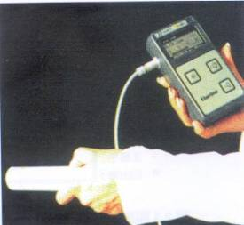
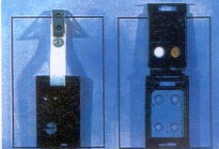
Ionizing radiation operation
Approval by or registration with competent authority is mandatory for operations involving radioactive materials (sealed, non-sealed radioactive source), ionizing-radiation equipment (e.g. X-ray machine) or radiation.
Radiation operators should bear radiation exposure badge to prevent overdose exposure (or monitoring of operating environment).
Handheld radiation detector
Ionizing Radiation Protection Act &
Safety Standards for Protection against Ionizing Radiation
Radiation exposure badge
Notes:
57
補充說明:
《補充》游離輻射防護安全標準(94.12.30.)
第7 條： 輻射工作人員職業曝露之劑量限度，依下列規定：
一、每連續五年週期之有效劑量不得超過一百毫西弗，且任何單一年內之有效劑量不得超過五十毫西弗。
二、眼球水晶體之等價劑量於一年內不得超過一百五十毫西弗。
三、皮膚或四肢之等價劑量於一年內不得超過五百毫西弗。
第12條： 輻射作業造成一般人之年劑量限度，依下列規定：
一、有效劑量不得超過一毫西弗。
二、眼球水晶體之等價劑量不得超過十五毫西弗。
三、皮膚之等價劑量不得超過五十毫西弗。
游離輻射防護法（ 91.1.30 ）
第 29 條
放射性物質、可發生游離輻射設備或輻射作業，應依指定申請許可或登記備查，主管機關同意後，始得進行輻射作業。
置有高活度放射性物質或高能量可發生游離輻射設備之高強度輻射設施之運轉，應由合格之運轉人員負責操作
第 15 條
為確保輻射工作人員所受職業曝露不超過劑量限度並合理抑低，雇主應對輻射工作人員實施個別劑量監測。但經評估輻射作業對輻射工作
人員一年之曝露不可能超過劑量限度之一定比例者，得以作業環境監測或個別劑量抽樣監測代之…..
第 32 條
設施經營者應對放射性物質、可發生游離輻射設備或其設施，每年至少偵測一次，提報主管機關偵測證明備查，偵測項目由主管機關定之

Slide 58

Ionizing radiation operation (cont.)
Detect radioactive materials and ionizing-radiation equipment and facilities at least once a year and submit the results to competent authority as reference.
Radiation warning sign
Handheld radiation detector
Protective method for ionizing radiation &
Safety standards for protection against ionizing radiation
Radiation exposure badge
Notes:
58
補充說明:
《補充》游離輻射防護安全標準(94.12.30.)
第7 條： 輻射工作人員職業曝露之劑量限度，依下列規定：
一、每連續五年週期之有效劑量不得超過一百毫西弗，且任何單一年內之有效劑量不得超過五十毫西弗。
二、眼球水晶體之等價劑量於一年內不得超過一百五十毫西弗。
三、皮膚或四肢之等價劑量於一年內不得超過五百毫西弗。
第12條： 輻射作業造成一般人之年劑量限度，依下列規定：
一、有效劑量不得超過一毫西弗。
二、眼球水晶體之等價劑量不得超過十五毫西弗。
三、皮膚之等價劑量不得超過五十毫西弗。
游離輻射防護法（ 91.1.30 ）
第 29 條
放射性物質、可發生游離輻射設備或輻射作業，應依指定申請許可或登記備查，主管機關同意後，始得進行輻射作業。
置有高活度放射性物質或高能量可發生游離輻射設備之高強度輻射設施之運轉，應由合格之運轉人員負責操作
第 15 條
為確保輻射工作人員所受職業曝露不超過劑量限度並合理抑低，雇主應對輻射工作人員實施個別劑量監測。但經評估輻射作業對輻射工作
人員一年之曝露不可能超過劑量限度之一定比例者，得以作業環境監測或個別劑量抽樣監測代之…..
第 32 條
設施經營者應對放射性物質、可發生游離輻射設備或其設施，每年至少偵測一次，提報主管機關偵測證明備查，偵測項目由主管機關定之

Slide 59
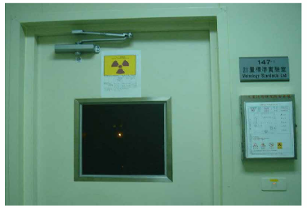
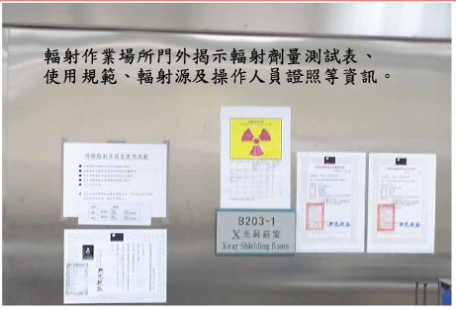
Ionizing radiation operation (cont.)
Laboratory should formulate proper guidelines for protection and operation of ionizing radiation and post it at conspicuous spot in working area.
Demarcate proper radiation control area, subject to control measures, and conduct radiation detection in monitoring area, plus environmental radiation detection for area neighboring workplace.
Protective method for ionizing radiation &
Safety standards for protection against ionizing radiation
Notes:
59
補充說明:
游離輻射防護安全標準(94.12.30)
第 4 條：輻射標誌之樣式顏色及示警
視需要於標誌上或附近醒目位置提供示警內容
工作檯、放射性物質處理盤、盛裝放射性物質之容器，冰箱、抽氣櫃、廢料桶、水槽等均貼有適當輻射警示標誌及警語
游離輻射防護法第 10 條（91.01.30）：
設施經營者應依主管機關規定，依其輻射工作場所之設施、輻射作業特性及輻射曝露程度，劃分輻射工作場所為管制區及監測區。管制區內應採取管制措施；監測區內應為必要之輻射監測，輻射工作場所外應實施環境輻射監測。
圖片來源：黃文昌，ITRI 輻射安全防護管理實務簡介，工業技術研究院，九十六年五月十日。

Slide 60
Safety management 5+1S
Refer to effective management of production factors, including personnel, machine, materials, and method, at production site: Push 5+1S movement (sorting out, reorganization, sweeping, cleaning, education, safety)
Common points of notice for laboratory safety management*
Placement of matters at designated spots.
Prepare two or more outlets, if possible, for workplace.

Slide 61
Safety management 5+1S (cont.)
Take into account compatibility factor in waste classification.
Opening of any chemical container shouldn't be set in the direction of persons.
Clear marking: Place sign of chemicals and forbidding activation of machinery
Electricity safety: Extension cord, ground connection

Slide 62
An ounce of prevention is worth a pound of cure.
Good laboratory safety and health management greatly reduced the proportion of injuries and accidents

Slide 63
Information source
Compiled by Chung Yuan Christian University
Edited by Yow-Jer Juang, Chang Jung Christian University
References:
1. Laboratory Safety and Hygiene Management - basic concepts
─ Yih-Yang Sheu, Taiwan Occupational Hygiene Association
2. Laboratory Safety and Hygiene Management - general education
─ Huan-Ping Chao, Department of Environmental Engineering, Chung Yuan Christian University

